Slide 1
DevOps Workshop, Part II

Slide 2
Agenda
WHY do we need this?
To understand what is waiting ahead.
DAY 1
DAY 1
Learn about docker containers.
Get acquainted with Kubernetes basic concepts.
Try launching your minimal stateless application.
Explore Kubernetes networking.
DAY 2
Learn how to configure your app on-the-go.
Go stateful.
Learn about templating.
DAY 3
Give your knowledge a challenge in DevOps practical task.
2

Slide 3
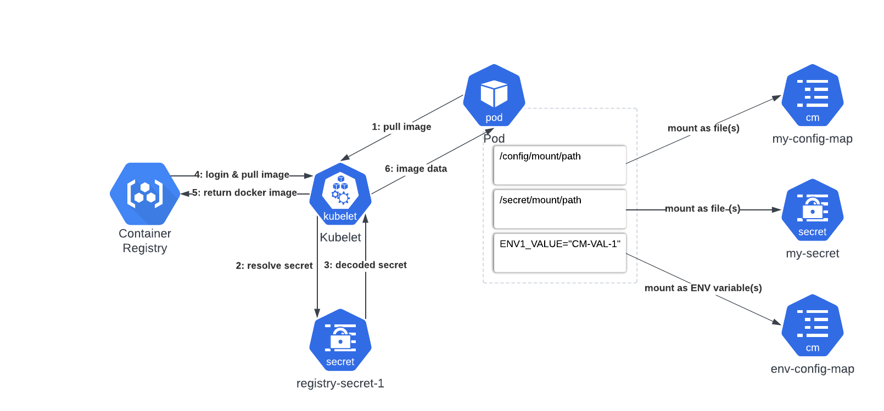
Configmaps & Secrets
WHY do we need this?
To ease configuration process.
3

Slide 4
Secret types
WHY do we need this?
To make secret purpose clearer for user.
Built-in Type | Usage
Opaque | arbitrary user-defined data
kubernetes.io/service-account-token | ServiceAccount token
kubernetes.io/dockercfg | serialized ~/.dockercfg file
kubernetes.io/dockerconfigjson | serialized ~/.docker/config.json file
kubernetes.io/tls | data for a TLS client or server
4

Slide 5


Q&A: story
WHY do we need this?
To see usecases.
I need to store DB credentials and configs somewhere… Definitely hardcoding them into docker container is not an option.
Try secrets and configmaps – they must be ideal for this purpose.
Alice
Bob
5

Slide 6
Task
WHY do we need this?
To practice (:
Create configMap to set NAME, USER, PASSWORD and RELATIVE_URL_ROOT env variables in deployment. Create ECR docker registry secret and use it as imagePullSecret.
6

Slide 7
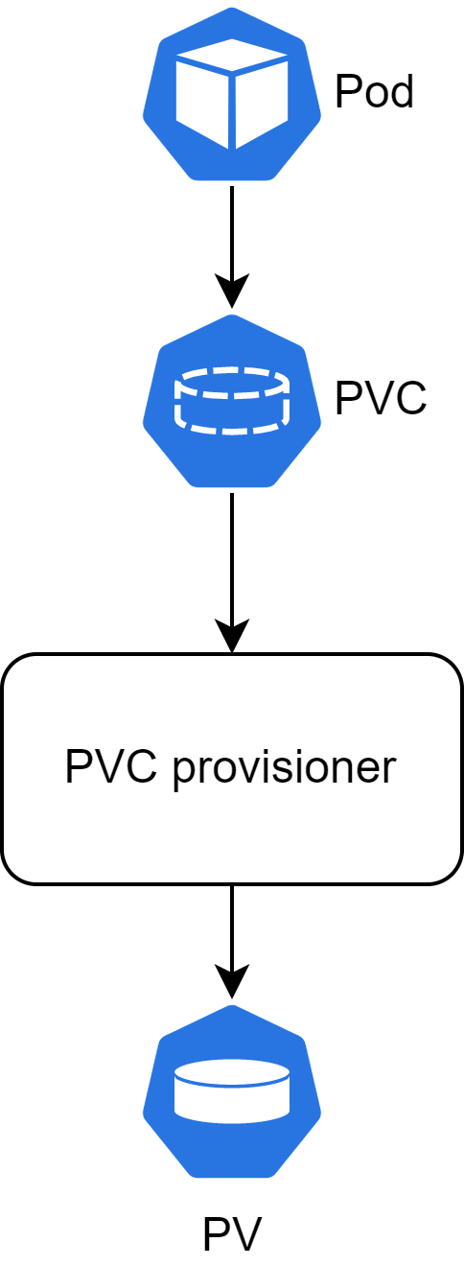
PV(C)
WHY do we need this?
To make applications stateful.
7

Slide 8
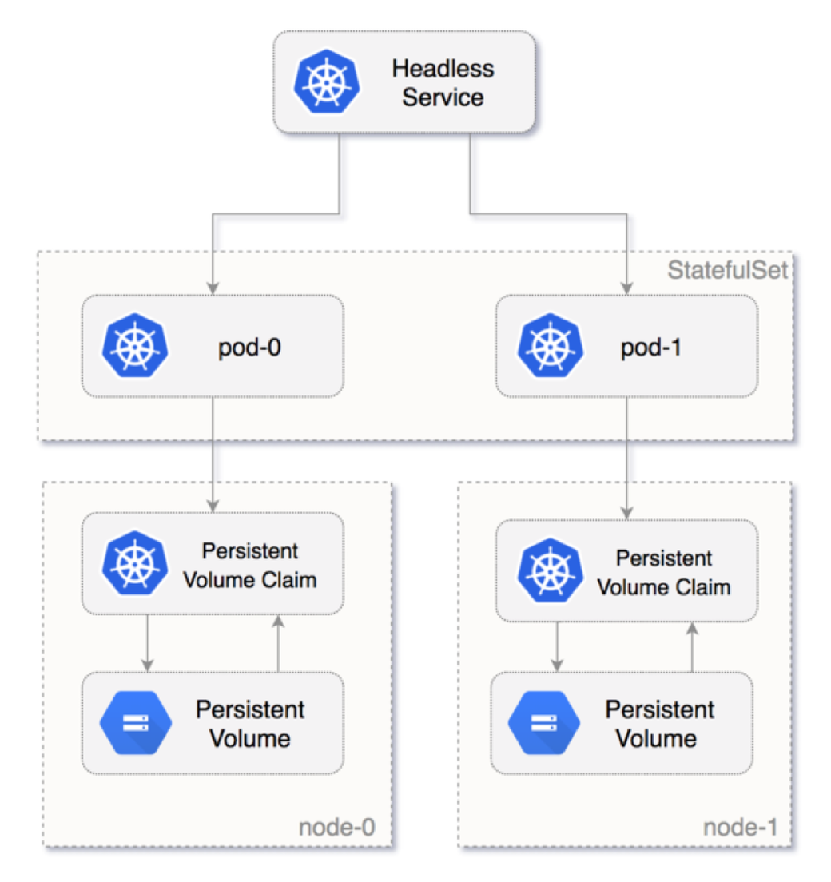
Stateful Sets
WHY do we need this?
To make stateful applications scalable.
8

Slide 9
Stateful Sets DNS
WHY do we need this?
To use cluster DNS for communication with distributed stateful applications.
Cluster Domain | Service (ns/name) | StatefulSet (ns/name) | StatefulSet Domain | Pod DNS | Pod Hostname
cluster.local | foo/nginx | foo/web | nginx.foo.svc.cluster.local | web-{0..N-1}.nginx.foo.svc.cluster.local | web-{0..N-1}
9

Slide 10
Q&A: story
WHY do we need this?
To see usecases.
My database that contains available teas can’t be stateless deployment ☹
Then make it stateful set! ☺
Alice
Bob
10

Slide 11
Task
WHY do we need this?
To practice (:
Turn your application into stateful set, requesting 512Mi with pvc mounted under /root/Documents directory with pod antiaffinity to each other. Try creating document in that folder and restart stateful set.
11

Slide 12
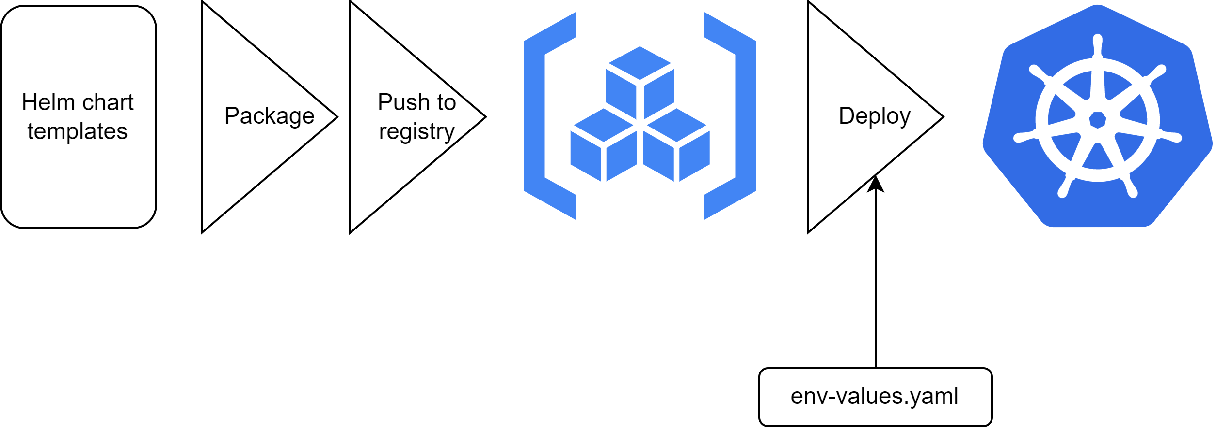
HELM
WHY do we need this?
To ease and unify deployment configuration for different envs.
12

Slide 13
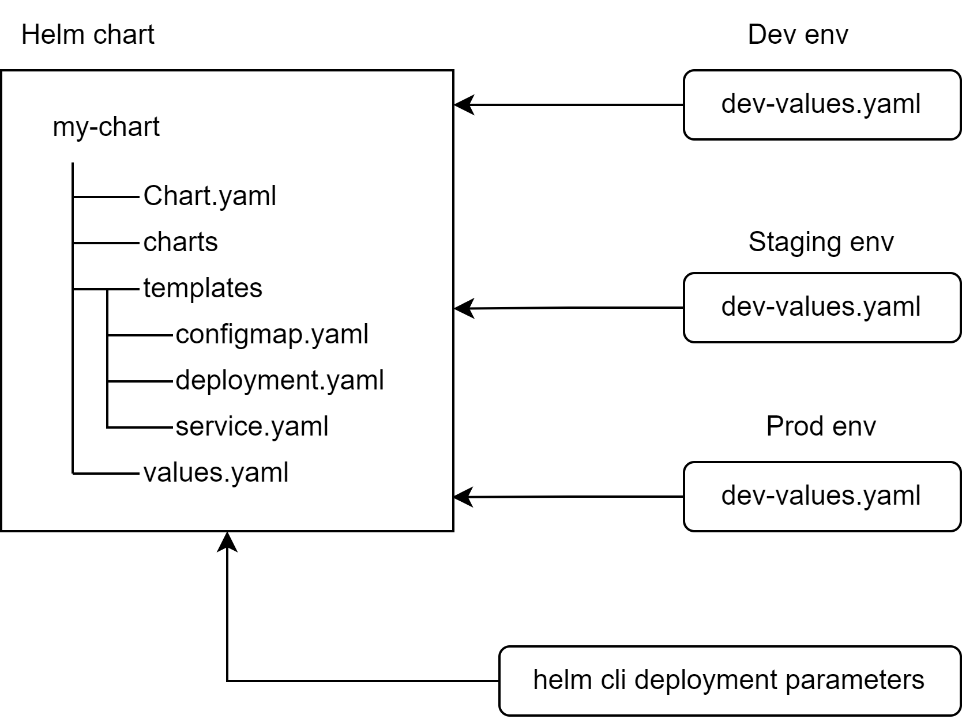
HELM Layout
WHY do we need this?
To ease and unify deployment configuration for different envs.
13

Slide 14
HELM Templating
WHY do we need this?
To ease and unify deployment configuration for different envs.
Template service.yaml
values.yaml
apiVersion: v1
kind: Service
metadata:
name: {{ include "my-chart.fullname" . }}
labels:
{{- include "my-chart.labels" . | nindent 4 }}
spec:
type: {{ .Values.service.type }}
ports:
- port: {{ .Values.service.port }}
targetPort: http
protocol: TCP
name: http
selector:
{{- include "my-chart.selectorLabels" . | nindent 4 }}
replicaCount: 1
image:
repository: nginx
service:
type: ClusterIP
port: 80
14

Slide 15
HELM Templating
WHY do we need this?
To ease and unify deployment configuration for different envs.
helm template my-release-name my-chart/
15

Slide 16
HELM Templating
WHY do we need this?
To ease and unify deployment configuration for different envs.
Template service.yaml
service.yaml
apiVersion: v1
kind: Service
metadata:
name: my-release-name-my-chart
labels:
helm.sh/chart: my-chart-0.1.0
app.kubernetes.io/name: my-chart
app.kubernetes.io/instance: my-release-name
app.kubernetes.io/version: "1.16.0"
app.kubernetes.io/managed-by: Helm
spec:
type: ClusterIP
ports:
- port: 80
targetPort: http
protocol: TCP
name: http
selector:
app.kubernetes.io/name: my-chart
app.kubernetes.io/instance: my-release-name
apiVersion: v1
kind: Service
metadata:
name: {{ include "my-chart.fullname" . }}
labels:
{{- include "my-chart.labels" . | nindent 4 }}
spec:
type: {{ .Values.service.type }}
ports:
- port: {{ .Values.service.port }}
targetPort: http
protocol: TCP
name: http
selector:
{{- include "my-chart.selectorLabels" . | nindent 4 }}
16

Slide 17
Q&A: story
WHY do we need this?
To see usecases.
Well, now I have my tea shop running, but development requires different environments with different configuration…
Give helm a chance!
Alice
Bob
17

Slide 18
Task
WHY do we need this?
To practice (:
Turn your application into helm-chart. Make mountpoint, ingress path, NAME, PASSWORD and USER configurable. Try setting another values with –set flag.
18

Slide 19
Reference
WHY do we need this?
To broaden knowledge.
Name | Link
Secrets | https://kubernetes.io/docs/concepts/configuration/secret/
Configmaps | https://kubernetes.io/docs/concepts/configuration/configmap/
PV/PVC | https://kubernetes.io/docs/concepts/storage/persistent-volumes/
Stetefulset | https://kubernetes.io/docs/concepts/workloads/controllers/statefulset/
Headless Service | https://itnext.io/exposing-statefulsets-in-kubernetes-698730fb92a1 https://kubernetes.io/docs/concepts/services-networking/service/#headless-services
Helm | https://helm.sh/docs/howto/charts_tips_and_tricks/
19

